Slide 1
Smart Electricity
Meter Solution
Quectel QuecPython

Slide 2
Overview of QuecPython
Current Situation of Smart Electricity Meter Solution
Secondary Development of Smart Electricity Meter Solution

Slide 3




Development Language——QuecPython
Cross-platform
Dynamic Loading
The application code can be switched seamlessly among multiple Quectel IoT modules without changing
Dynamically load scripts
Application upgrade is more convenient and flexible
Increasing Popularity of Embedded Development
No Compilation Required
Easy to Learn
Natural language programming makes you write code like an article
Rich application frameworks make it available for new developers to develop products
With object-oriented design, you can easily develop products even if you don’t know C language
No compilation required
What you “write” is what you “get”
Compilation and debugging integration
www.quectel.com

Slide 4
Framework Diagram of the Feature of Cross-platform
① The Python source code
② by the Python interpreter
③ is interpreted into Python bytecode,
④ which is given to the Python virtual machine on each platform
⑤ and call the platform interface to execute the function.
Python Source Code
Python Interpreter
+
Python Bytecode
Python Virtual Machine on Platform 1
Python Virtual Machine on Platform 2
Python Virtual Machine on Platform N
Platform 1
Platform 2
Platform N

Slide 5



Application Scenarios of QuecPython
Rich Solutions by Industry
Cloudspeaker
Smart Tracker
Magnetic Door Contact
4G Gateway
Public Network Interphone
DTU
Electronic Student ID Card
Two-wheeler Meter
Industrial Control Meter
Vending Machine
Mobile Payment
2. Basic Framework of
Industry Application
Charging Pile for Two-wheeler
Two-wheeler Meter
4G Electricity Meter
Medical Device
Abundant Features Support Your Business Development
Connect to the Public Cloud Platform
Alibaba Cloud Payment
WeChat Talkback and Voice Messaging
Data Science Computing（NumPy）
Test to Speech

Slide 6
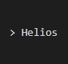


QuecPython Development Tool
HeliosSDK/ToolChain + QPYcom + VSCode/Plugin
Multiple development tools
Help developers manipulate QuecPython
HeliosSDK/ToolChain
For senior developers
More drivers and algorithms can be added to the bottom of system
Features of QuecPython virtual machines can be configured on demand
……
QPYcom Integration Tool
REPL Interaction
File Transfer
Firmware Synthesis and Download
……
VSCode+Plugin
Write codes with VSCode
Assist in QuecPython development with Plugin:
REPL interaction, file transfer, firmware download
……
www.quectel.com

Slide 7
QuecPython Firmware Generation Process
QuecPython VSCode Plugin
(Original)
QuecPython Firmware
+
QuecPython Script Files
QPYcom
(New)
QuecPython Firmware
Download
Notes:
由QuecPython SDK环境编译生成包含虚拟机功能的原始固件
使用代码编辑器编写QuecPython脚本文件
原始固件和脚本文件，在QPYcom工具的作用下，生成新的固件
新的固件通过QPYcom烧录进模组中，此时模组的文件系统就已经包含了脚本文件

Slide 8
Overview of QuecPython
Current Situation of Smart Electricity Meter Solution
Secondary Development of Smart Electricity Meter Solution

Slide 9
QuecPython Solves Pain Points of Smart Electricity Meter Solution
Pain Points
QuecPython Solution
Accumulate Industry Experience
Export Overseas
Uncertain countries or regions make it difficult to select the appropriate module.
With accumulated industry experience, we can guide you in selecting module models to reduce your difficulties.
Long Development Cycle and Poor Cross-platform Performance
Short Development Cycle and Thrilling Cross-platform Performance
Development in OpenC makes it difficult to unify the development environment and software interfaces, leading to a long learning and development cycle.
Stable business framework and bottom components contribute to a short development cycle. Unified interfaces are applicable for multiple platforms.
High Hardware Cost
Save Hardware Cost
Development in AT command solution requires the external MCU, increasing the hardware cost.
Dispense with MCUs to save the hardware cost

Slide 10
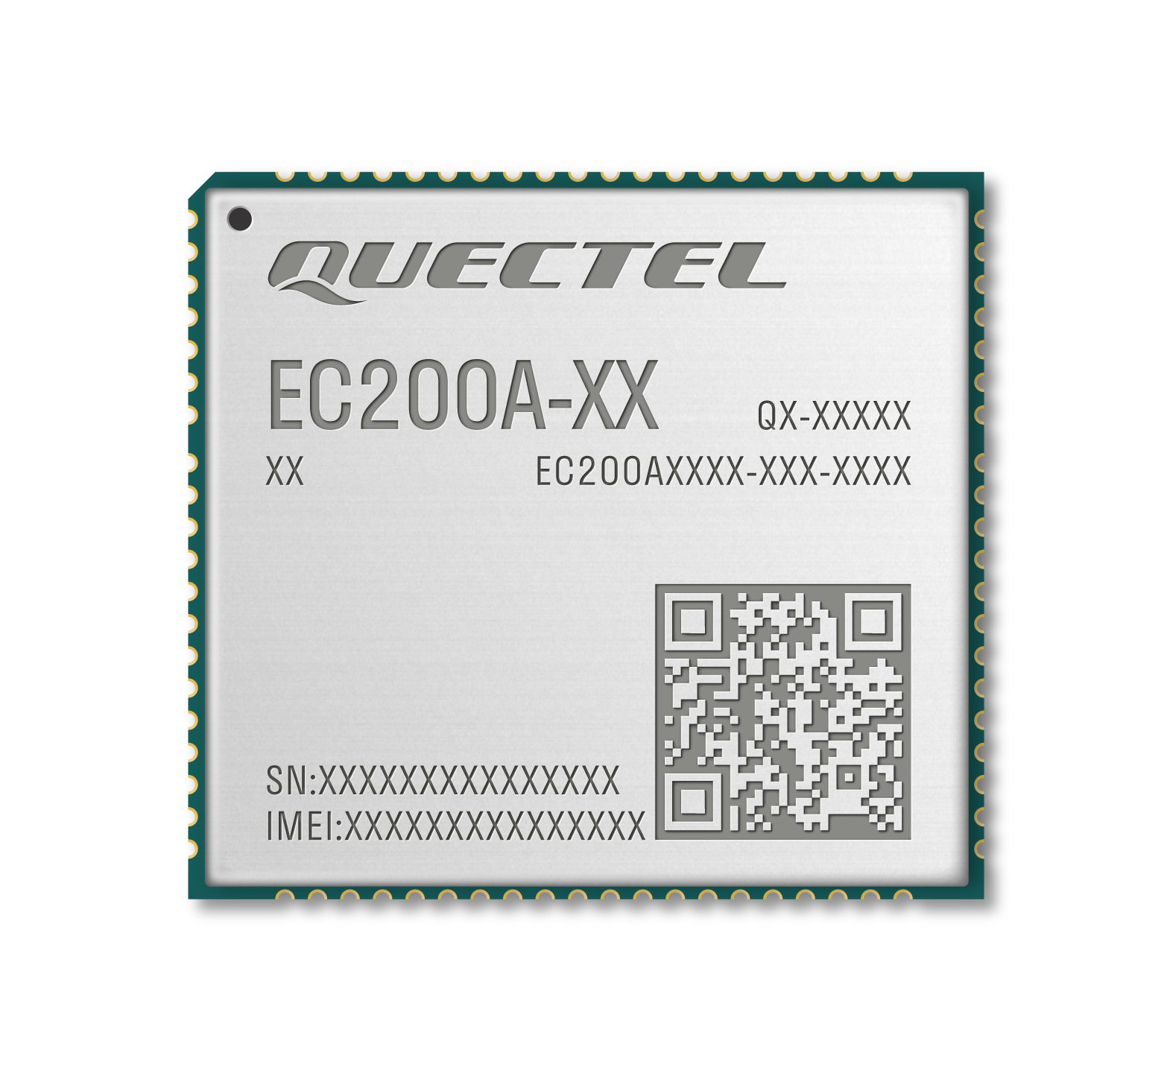
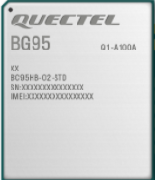

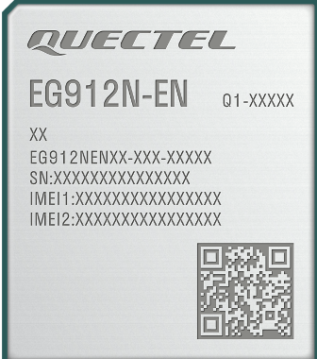
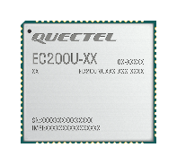
Modules in Mass Production
BG95 series#
Qualcomm MDM9205
19.9x23.6 mm
LGA
NB
EC200A-EU/AU
ASR 1803
32x29 mm
LCC
4G+3G+2G
EG912N-EN
ASR1603
FF: 25x29 mm
LGA
4G+2G
EC200U-EU
Unisoc 8910DM
FF: 31x28 mm
Pin EC2x/ EC200T/
4G+2G

Slide 11
Successful Cases
Ningxia Hui Autonomous Region
Multiple customer projects are under development.
Henan Province
Multiple customer projects are under development.
Zhejiang Province
Some customer projects are in mass production state and multiple products have been updated rapidly.
Multiple customer projects are under development.
Hunan Province
Customer projects are under steady development and near the end, coming to mass production.
Guangdong Province (Shenzhen City)
Multiple customer projects are under development.

Slide 12
Overview of QuecPython
Current Situation of Smart Electricity Meter Solution
Secondary Development of Smart Electricity Meter Solution

Slide 13
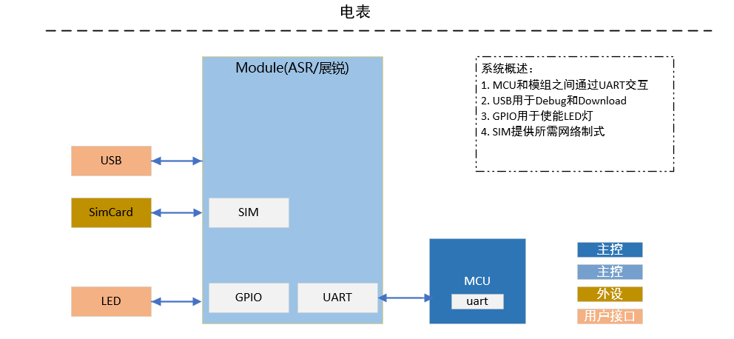
Hardware Block Diagram
Electricity Meter
Module
System Overview
The module communicates with MCU through UART port to implement data interaction.
USB is used for debugging and downloading.
GPIO is used for enabling LED light.
The required network mode is provided by SIM card.
SIM卡
Master Control
UART
Peripheral
User Interface

Slide 14
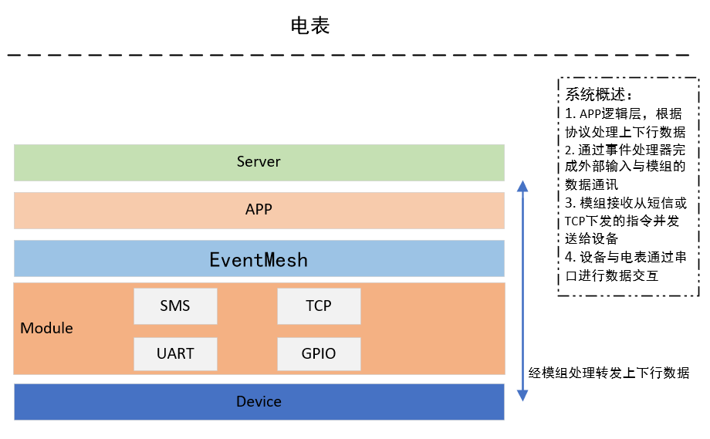
Function Block Diagram
Electricity Meter
System overview:
Application logic layer processes the uplink and downlink data through protocols.
The external input and data communication with the module are implemented by EventMesh.
The module receives the command sent through SMS or TCP protocol and forwards the command to the device.
The data is transmitted through UART between the device and the electricity meter.
Application Layer
Event Processor (EventMesh)
The module processes and forwards the uplink and downlink data.

Slide 15






Secondary Development Components
EventMesh
Event Manager
RFC1662/DLMS
Electricity Meter Protocol Analysis
网络管理
网络自动重连、状态管理
Network Management
Automatic Network Reconnection
Network State Management
Parameter Storage Management
Addition, Deletion, Verification and Modification of Persistence Parameters
TCP Mode Management
Switch Between the Client Mode and Server Mode
FOTA
固件及应用升级
Firmware and Application Upgrades

Slide 16
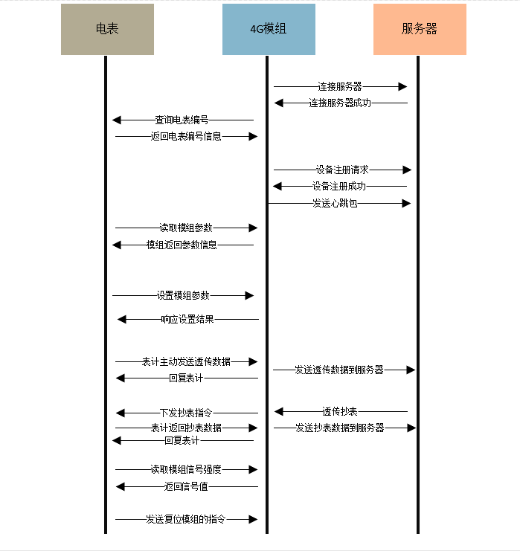
Business Process
Meter
Module
Server
Connect to the server
Connected successfully
Query the meter number
Return the meter number information
Request for device registration
Device is registered successfully
Sent a heartbeat packet
Read the module parameter
Parameter information is returned by the module
Set module parameter
Return the setting result
Send transparent transmission data
Reply to the meter
Send transparent transmission data
Issue command of meter reading
Request for meter reading
Return meter reading data
Send the data read
Reply to the meter
Read the module signal strength
Return the signal value
Send the command to reset the module

Slide 17
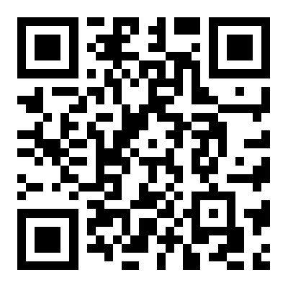

Reference Materials
QuecPython Official Website:
https://python.quectel.com
QuecPython Wiki API Documantation:
https://python.quectel.com/wiki
Quectel Tmall Flagship Store
https://yiyuanznsb.tmall.com/
QuecPython WeChat
Official Account

Slide 18




The number one cellular module vendor in the world and a leading GNSS module supplier
Unbeatable choice from the broadest module portfolio in the world
The highest quality products for the best possible prices
Superb support with the largest R&D team in the industry
Continuous innovation – first to market with 5G, LPWA, CV2X, snapdragon
A passionate, dedicated team of “Quectelers” ensure our customers always come first
Building 5, Shanghai Business Park Phase III (Area B), No.1016 Tianlin Road, Minhang District, Shanghai 200233, China
Tel: +86 21 5108 6236 • Email: info@quectel.com
Technical Support: support@quectel.com

